Slide 1
Probability
EQ – How do I calculate probabilities of single events?
Mrs James
Year 10

Slide 2
Lesson objective
By the end of this lesson you will be able to;
Calculate the expected frequency
Use the complement of an event to calculate the probability
Notes:
Lesson

Slide 3
From last lesson:
You can use probability to predict the proportion of times something will happen in the long run, but it cannot tell you what will definitely happen next.
e.g The probability of getting a tail the next time you throw a coin is always 0.5. It doesn’t matter if you have tossed 20 heads in a row, the probability is still 0.5.
While there is natural variation, the greater the number of trials, the closer the theoretical and experimental probabilities will be.
“The last banana” https://www.youtube.com/watch?v=Kgudt4PXs28

Slide 4
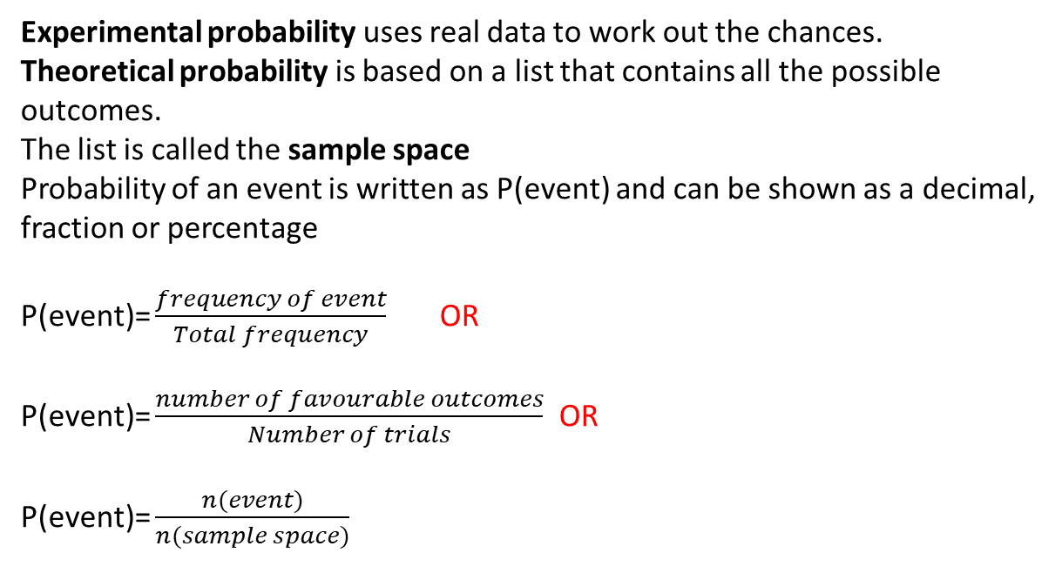
24
7
30
Date
Probability
EQ – How do I calculate probabilities of single events?
Experimental probability uses real data to work out the chances.
Theoretical probability is based on a list that contains all the possible outcomes.
The list is called the sample space
Probability of an event is written as P(event) and can be shown as a decimal, fraction or percentage
P(event)= $\frac{frequency of event}{Total frequency}$ OR
P(event)= $\frac{number of favourable outcomes}{Number of trials}$ OR
P(event)= $\frac{n(event)}{n(sample space)}$
Notes:
Input

Slide 5
24
7
30
Date
Probability
EQ – How do I calculate probabilities of single events?
Complement of an Event= all outcomes that are NOT the event.
P(A) means "Probability of Event A“
P(A') means "Probability of the complement of Event A"
The complement is shown by a little mark after the letter such as A’
The two probabilities always add to 1
P(A) + P(A') = 1
You can use the probability of an event to predict the number of times an event might happen.
This is called expected frequency
Expected frequency = Probability x number of trials
Notes:
Input

Slide 6
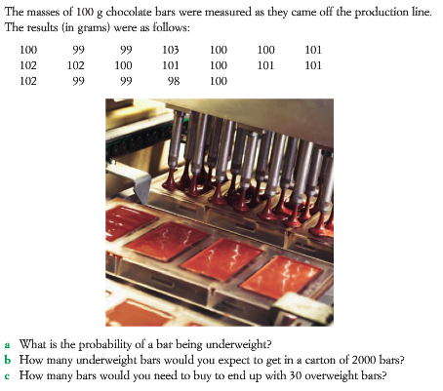
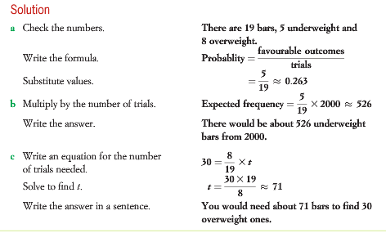
Example 1: We will do this together. Complete this in your Interactive notebook

Slide 7
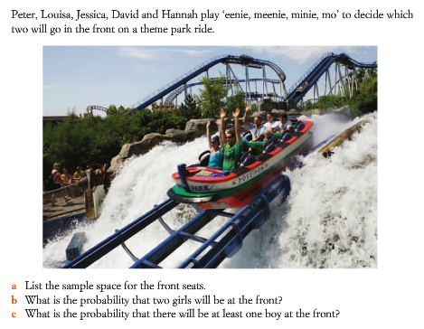
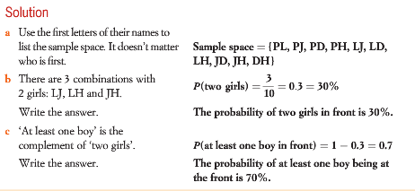
Example 2: We will do this together. Complete this in your Interactive notebook

Slide 8
Your turn to practice
Complete the following worksheet:
3_Single event probabilities worksheet
This worksheet will be on CONNECT along with this PowerPoint to support your revision and study of this topic.
Early finishers: Use NelsonWA Maths textbook Ex 6.1 p 235
Homework/Revision
Continue to work through the worksheet above
Write your summary of this topic

